Slide 1
Complexity
By: Riham Katout

Slide 2
Videos
1- part1
2- part2

Slide 3
Articles
1- Knowing the complexity in competitive programming
2- How to Analyse Loops for Complexity Analysis of Algorithms

Slide 4
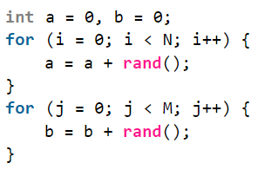
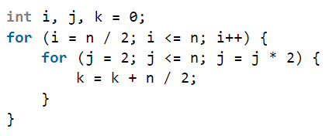
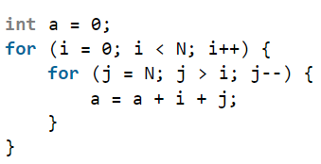
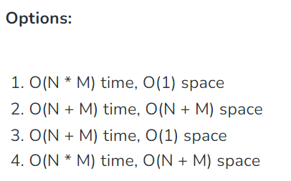
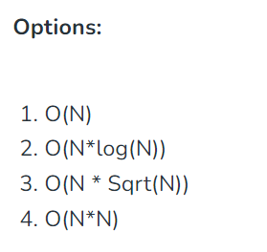
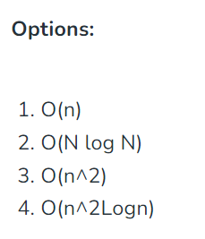



What is the time, and space complexity of the following codes ?
Solution
Solution
Solution

Slide 5
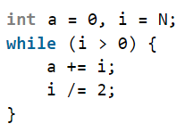
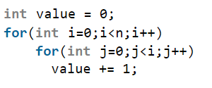

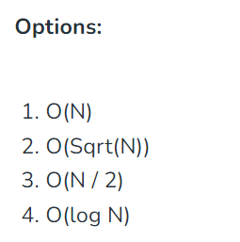
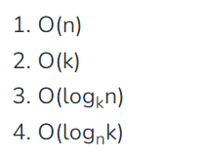
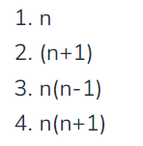



What is the time, and space complexity of the following codes ?
Solution
Solution
Solution

Slide 6
